Slide 1
New England CORAL Results
April 29, 2024

Slide 2
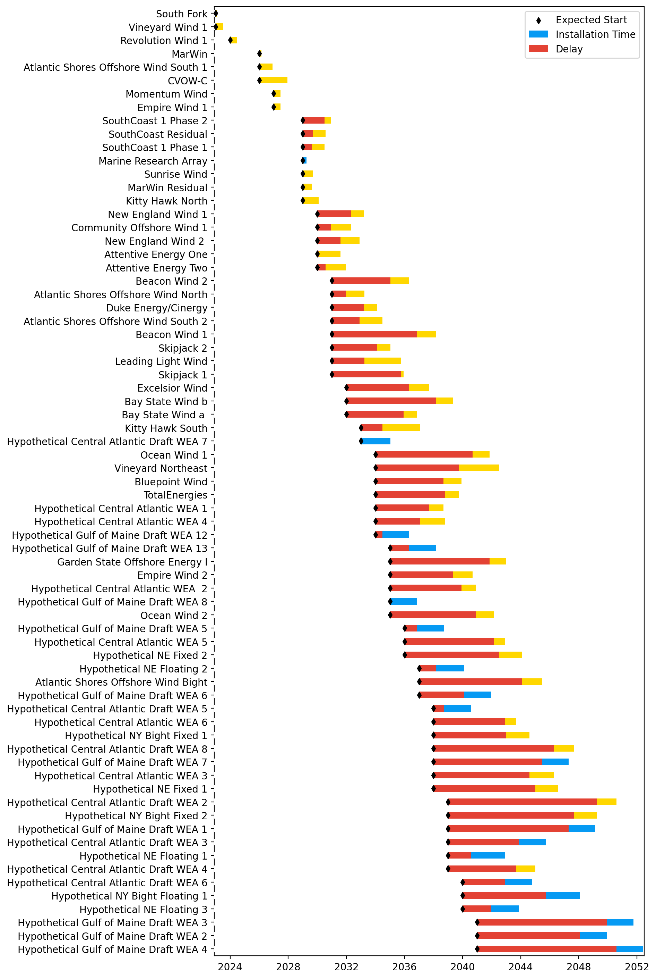
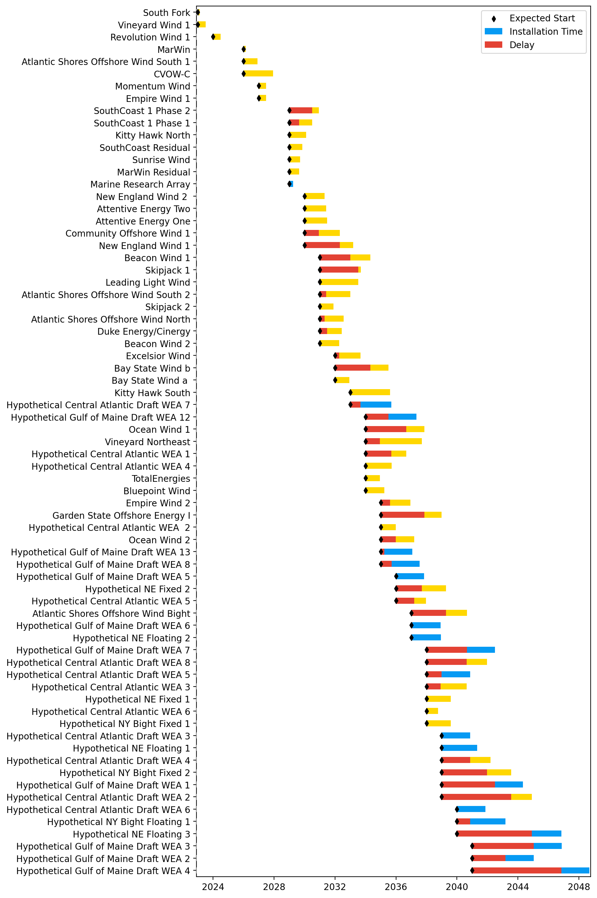
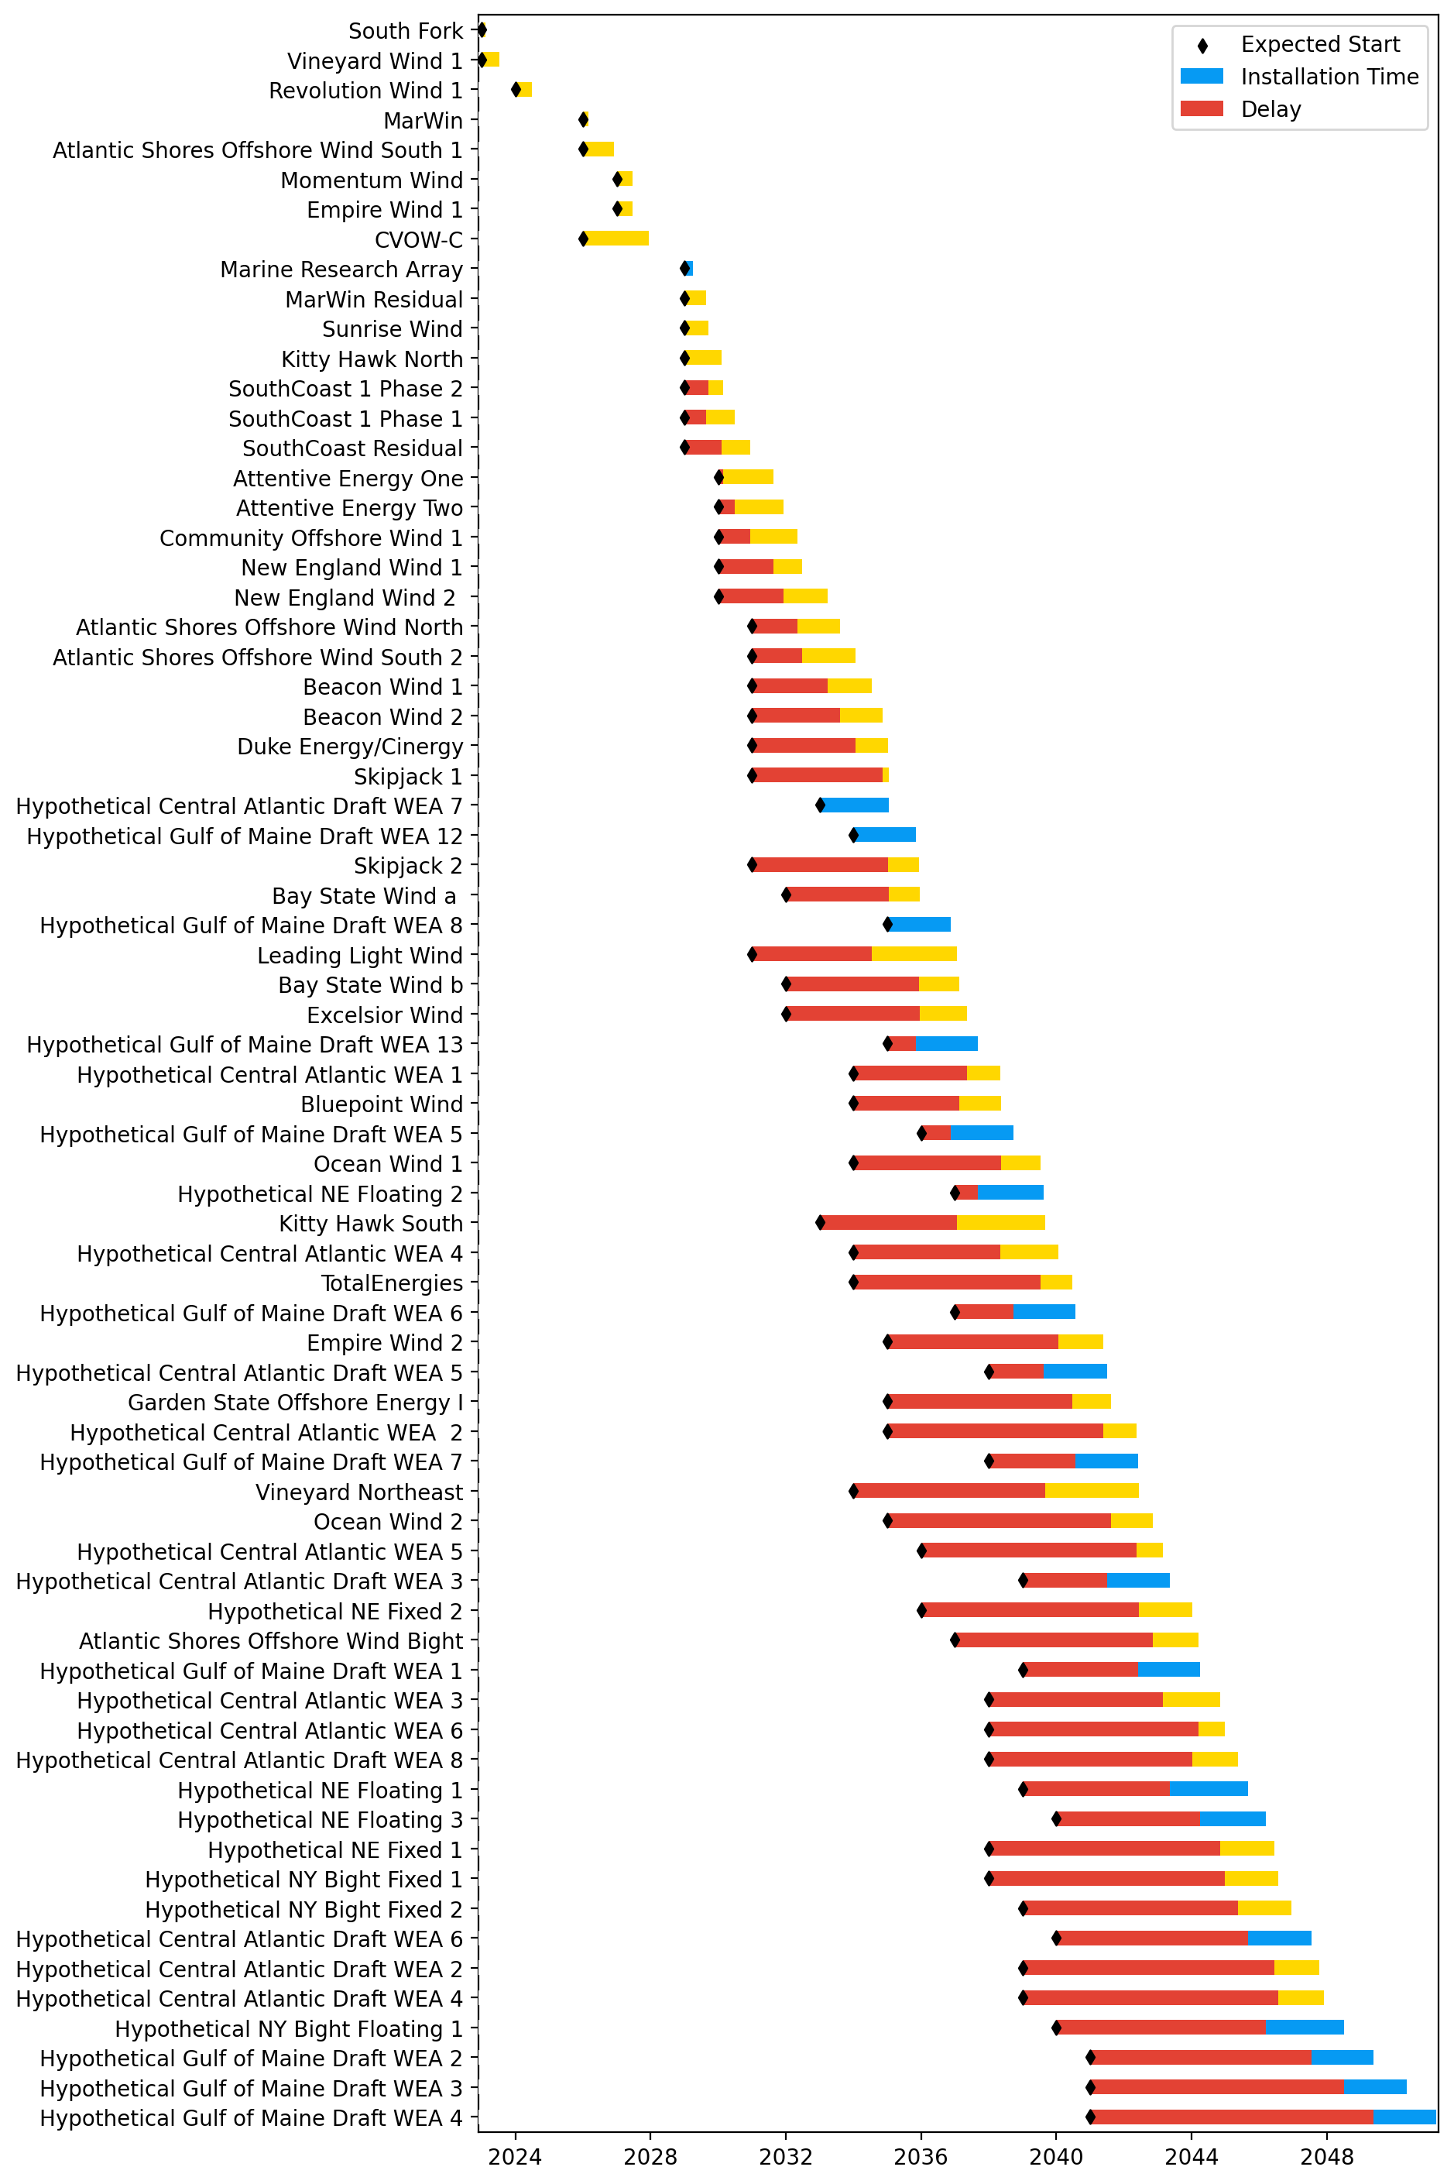
Base Vessel and Port Pathway
Unconstrained Vessels
Unconstrained Ports
Full Chart
Base pipeline

Slide 3
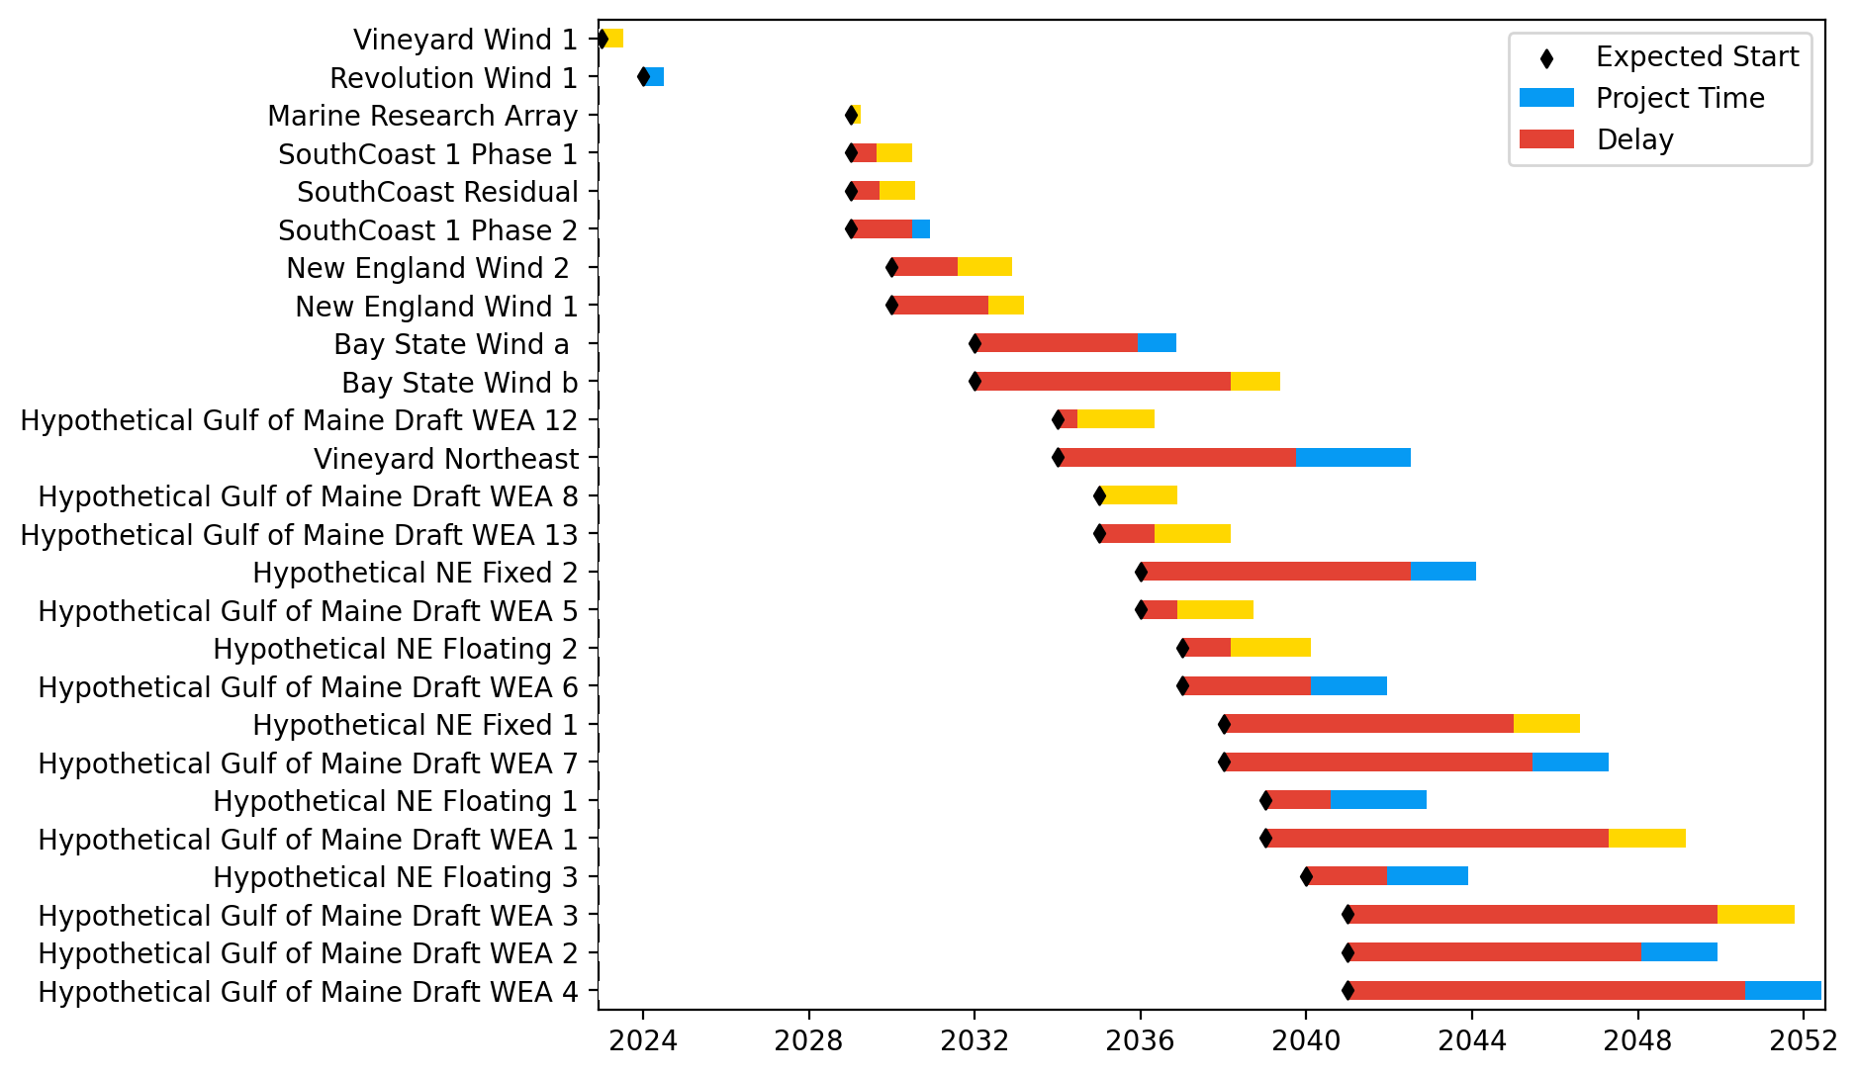
30 GW
New England Only
Base Pathway

Slide 4
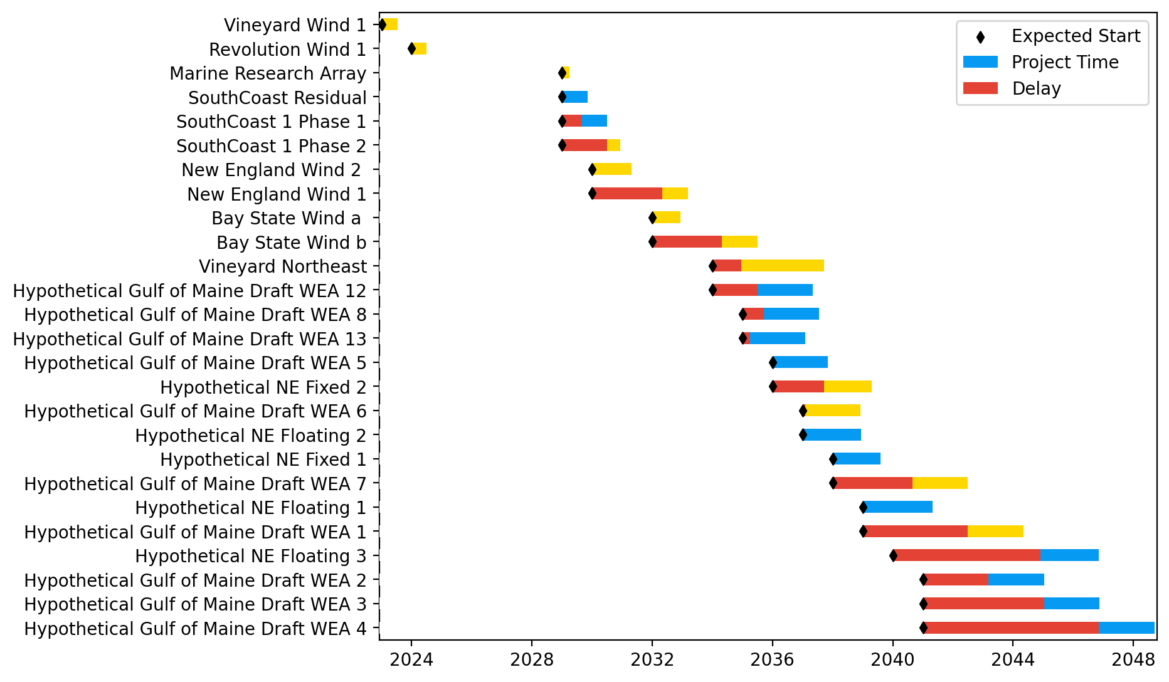
New England Only
Unconstrained Vessels

Slide 5
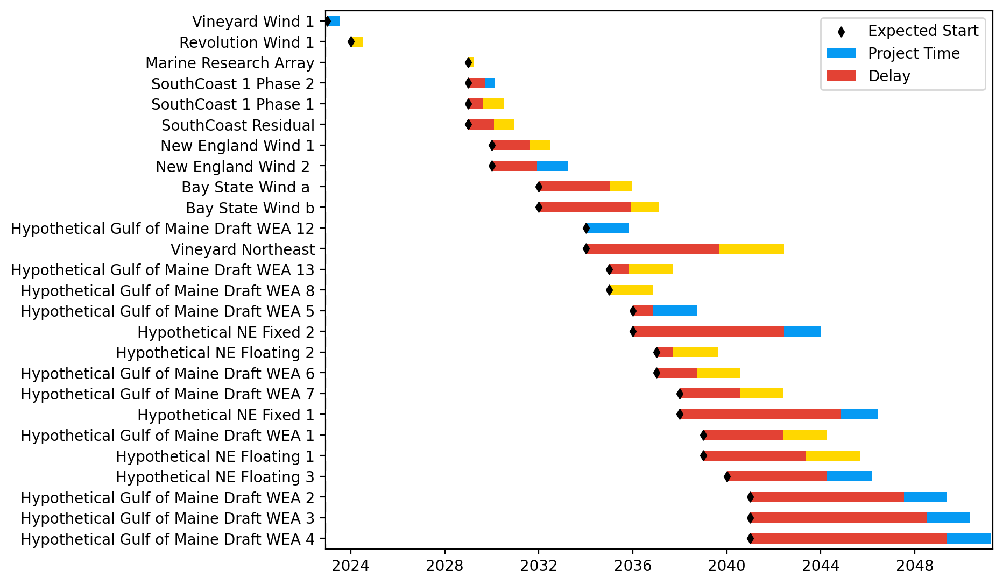
New England Only
Unconstrained Ports

Slide 6
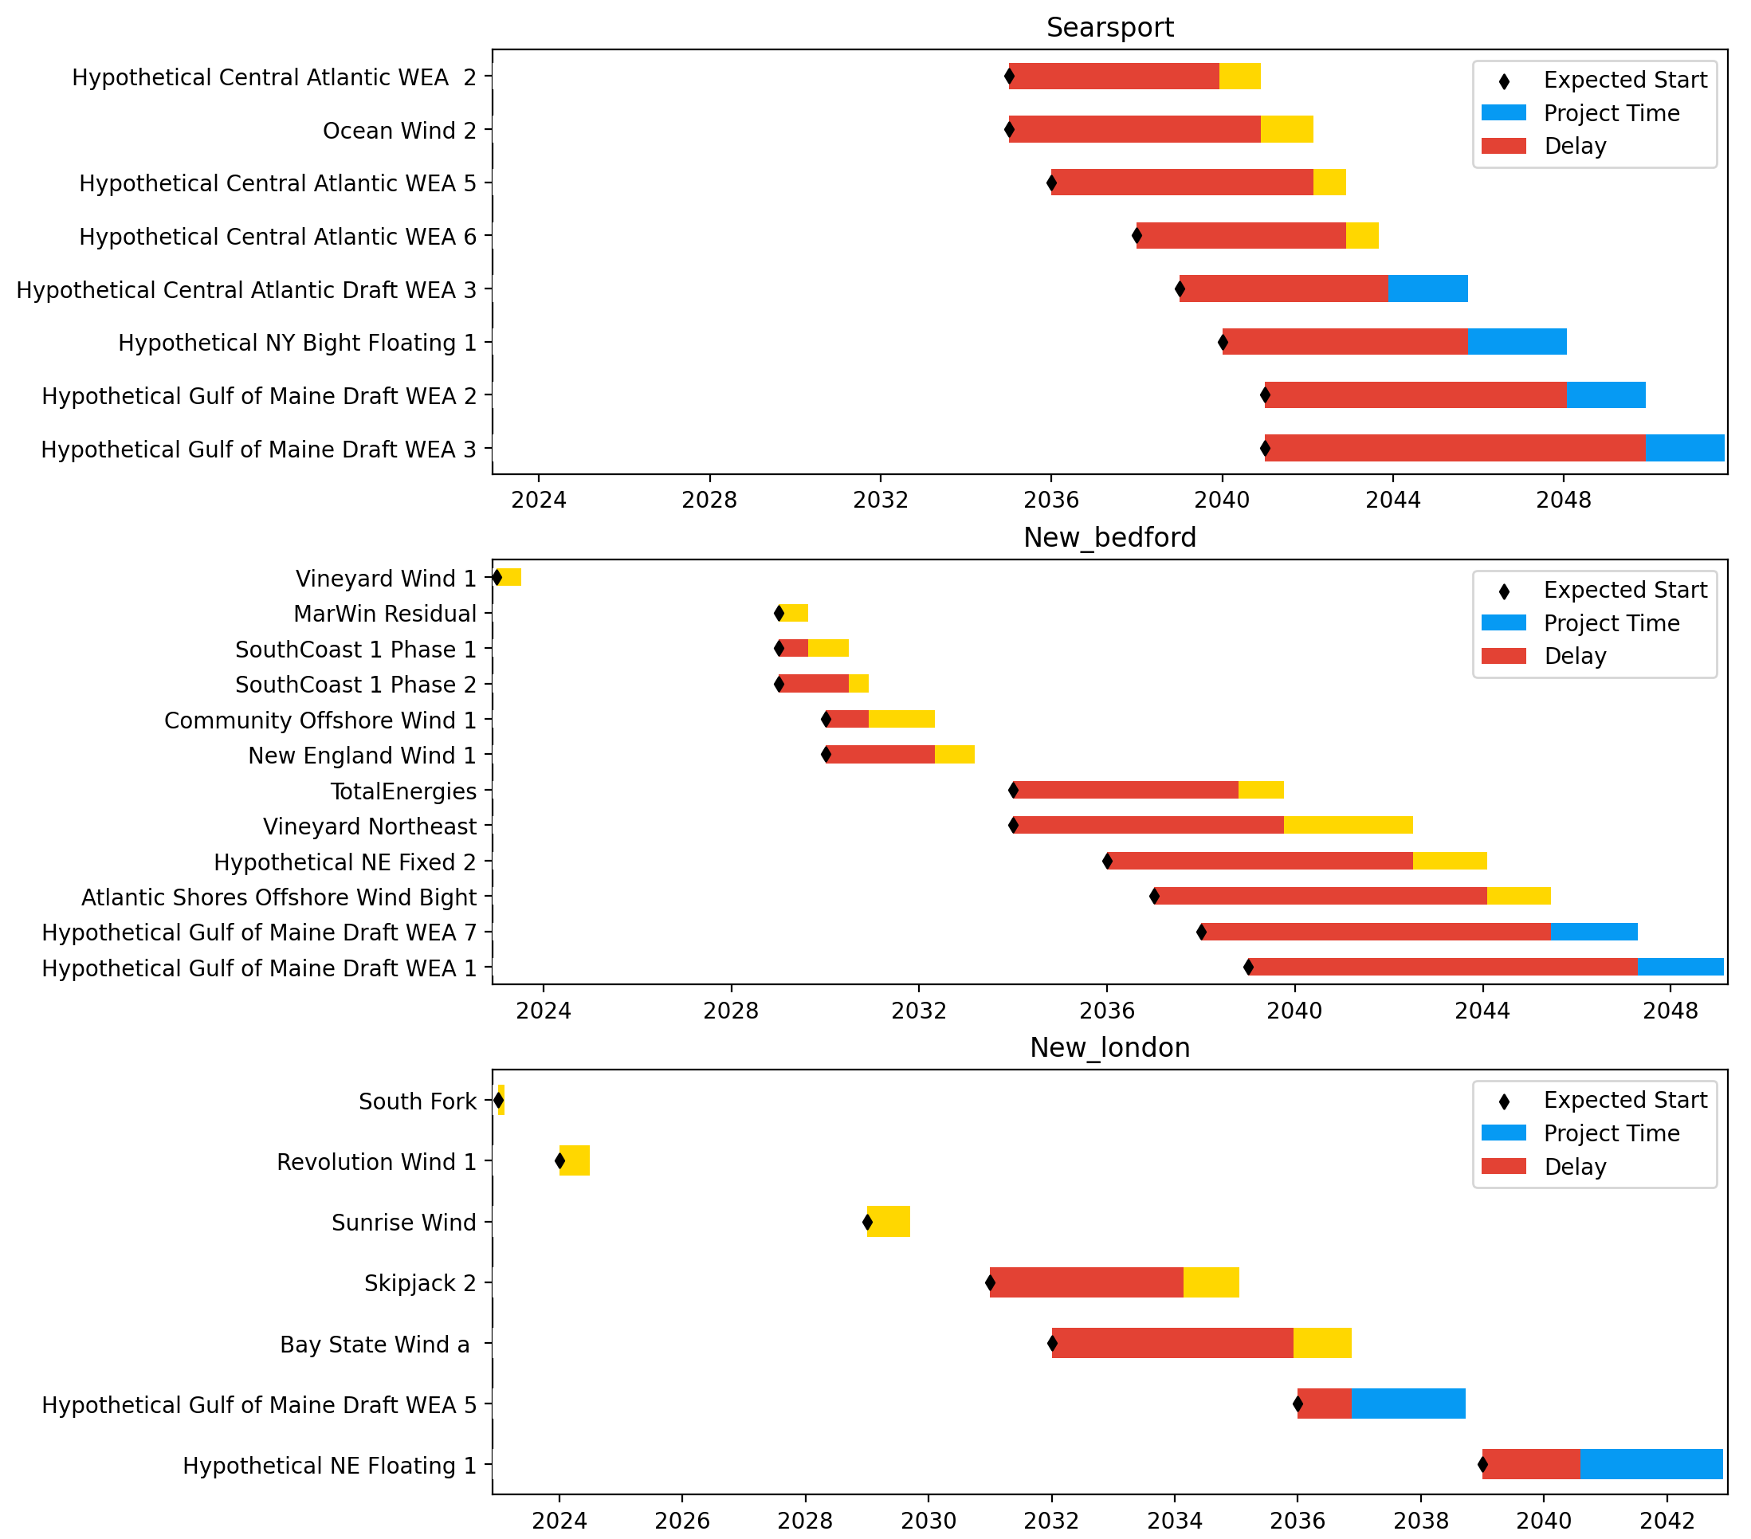
New England Ports
Base Pathway

Slide 7
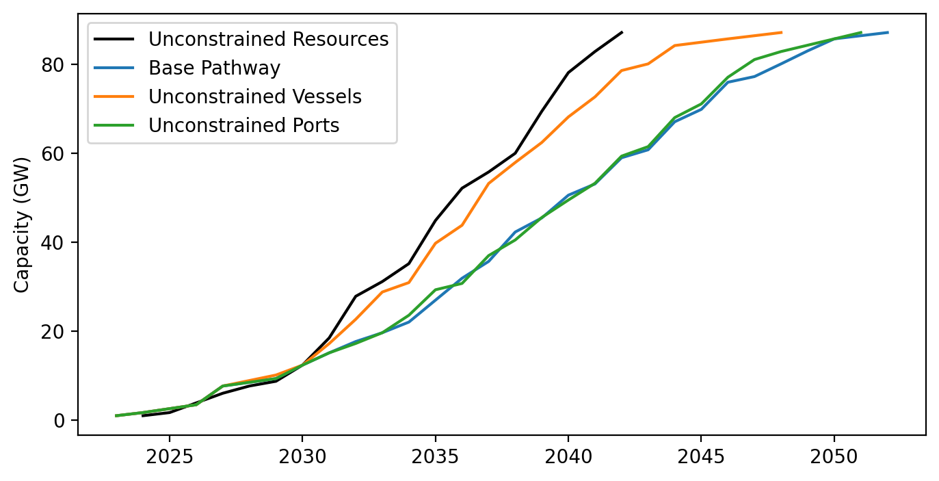
Cumulative Installed Capacity
Base Pathway

